Slide 1
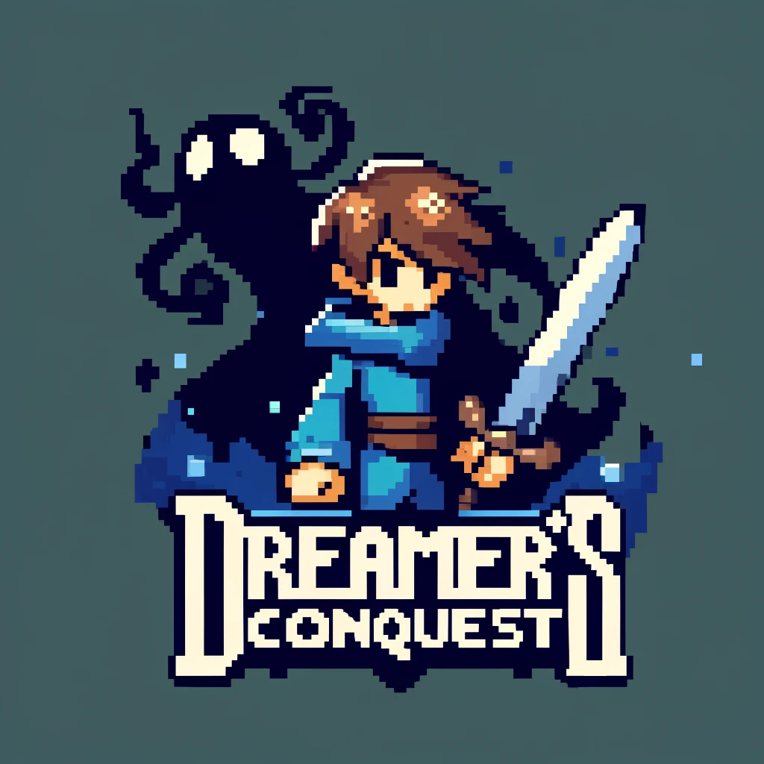
Videogame by Adilet Sooronbaev, Artyjom Csarkovszkij and Mean Diamand

Slide 2
Description
2D Pixel art Top-Down RPG
Medieval setting
Thrilling storytelling

Slide 3
Tech stack
Unity
C#
GitHub
Photoshop

Slide 4
Inventory
MVC
Inventory
InventorySlot
InventoryController
UIInventory
UIInventorySlot

Slide 5
Video demo of inventory
Here we could show in a video montage how the inventory works.

Slide 6
Skill upgrades
Description of skills

Slide 7
Level transition
Description of transition

Slide 8
Saving progress

Slide 9
Combat
Component-Based architecture
Player Game Object
Goblin Game Object
Skeleton Game Object
PlayerController
GoblinController
SkeletonController
Transform
Transform
Transform
HealthController
Damagable Character
Damagable Character

Slide 10
Video demo of a combat
Here we could present a video demo of how player attacks and shields from enemies.

Slide 11
Levels and cutscenes
The game has 3 levels.
Each level presents different environment.
Each player contains various monsters.
Player can transition between levels if he kills all the enemies.
Each transition is accompanied with a small cutscene
Comments: We also could show the levels and transitions in the video demo

Slide 12
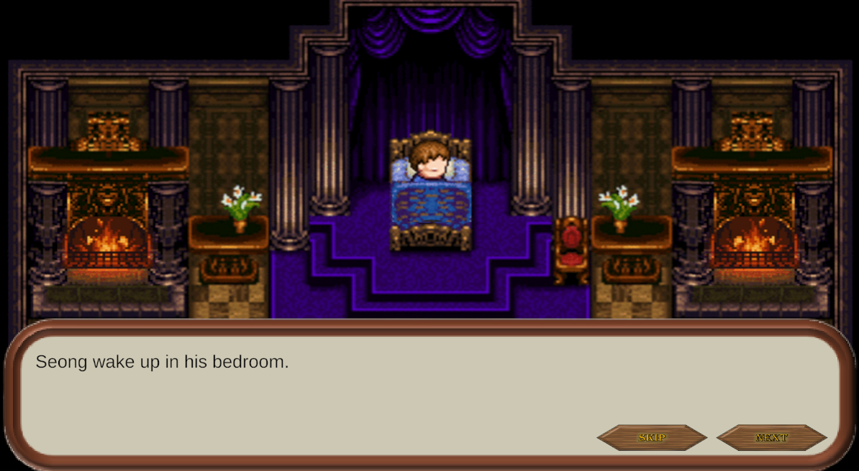
Cutscenes

Slide 13
UI
Our game has a simple User Interface.
When player is killed, he is presented with game over screen and the player can choose to either restart from the last checkpoint or quit the game.
Player can also pause the game to save it or navigate back to the main menu.
When player opens inventory, he is also presented with inventory interface.
Comment: For IU we can present some screenshots of how it looks

Slide 14
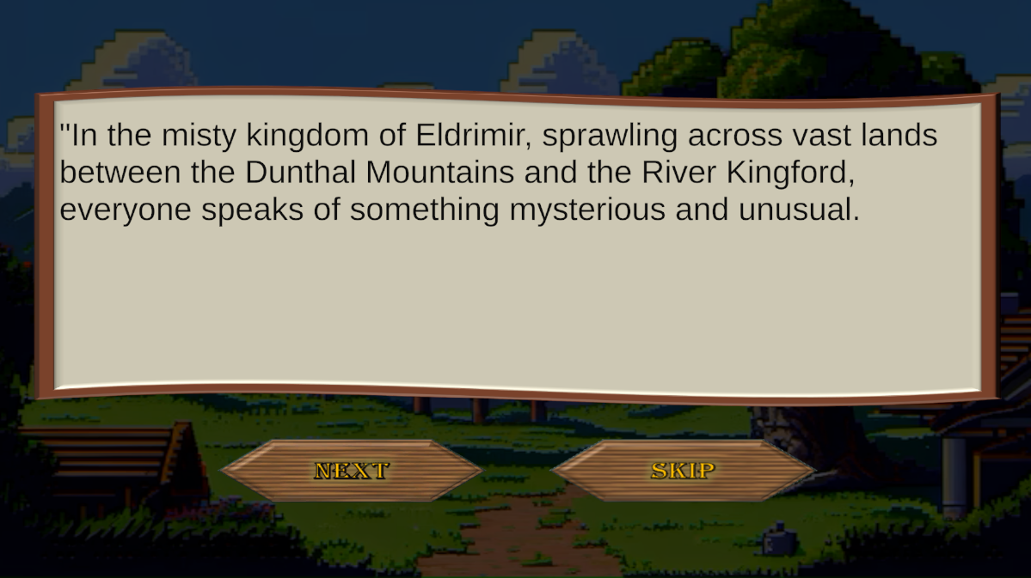
UI

Slide 15
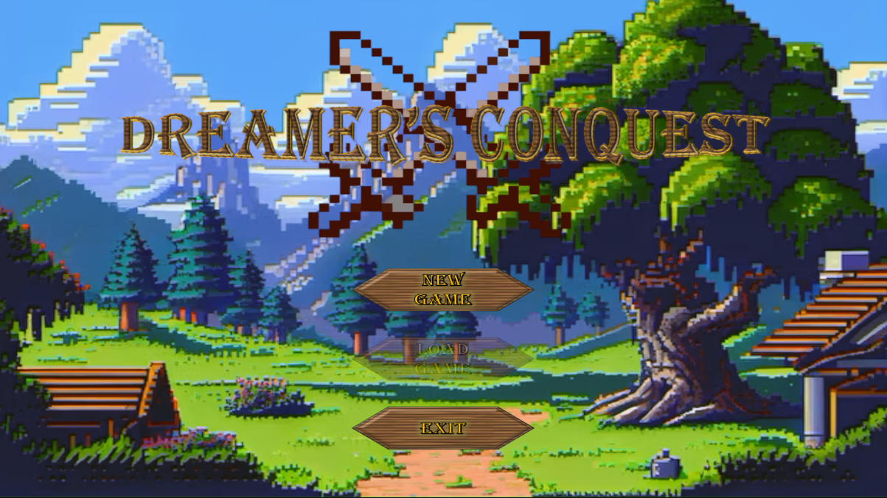
UI

Slide 16
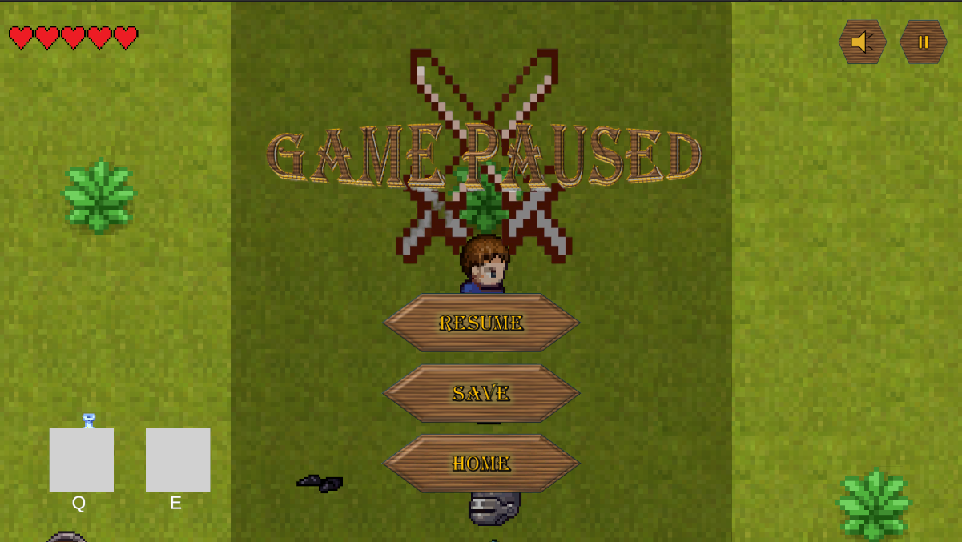
UI

Slide 17
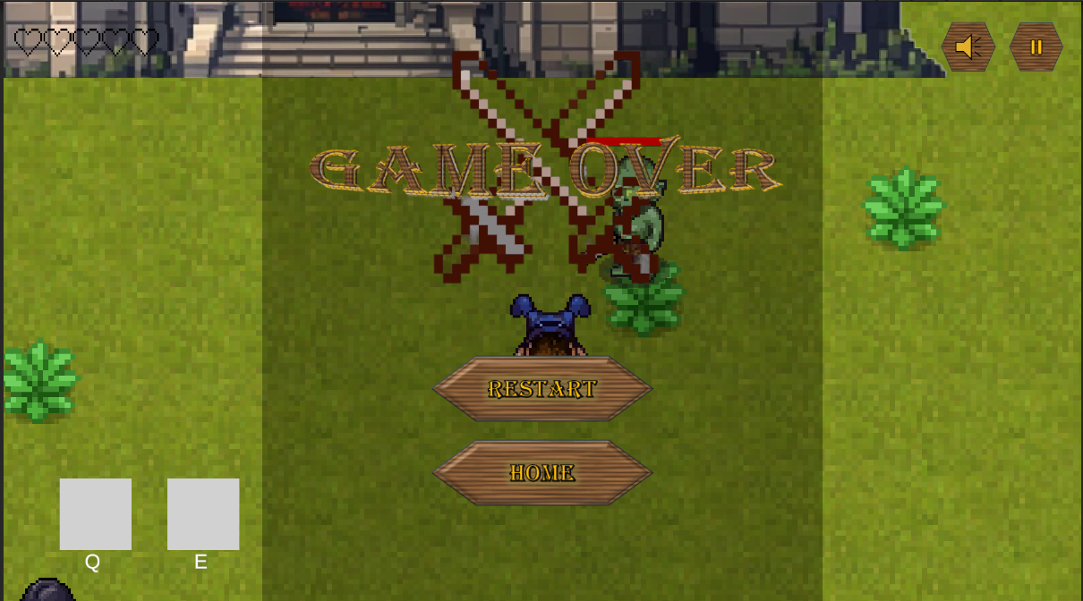
UI

Slide 18
Soundtrack
Our game uses non copyrighted soundtrack as a background music.
There are also sound effects for when the player is hitting and shooting the bow.
When the game is over for, there will also be the game over sound effect.
All of these sounds can be adjusted in the volume setting.
Comment: Might show a video demo of the soundtrack in the game.

Slide 19
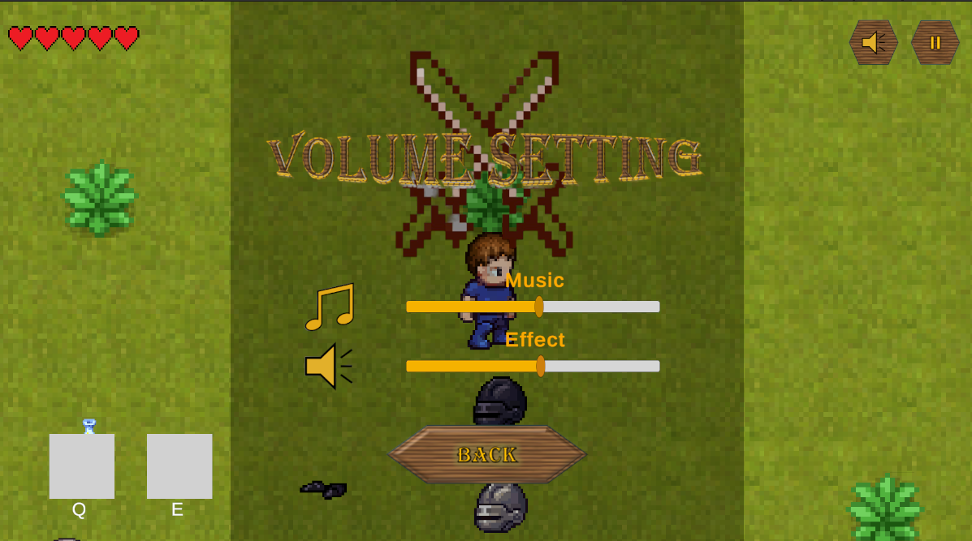
Soundtrack
Soundtrack
AudioManager
VolumeSetting

Slide 20
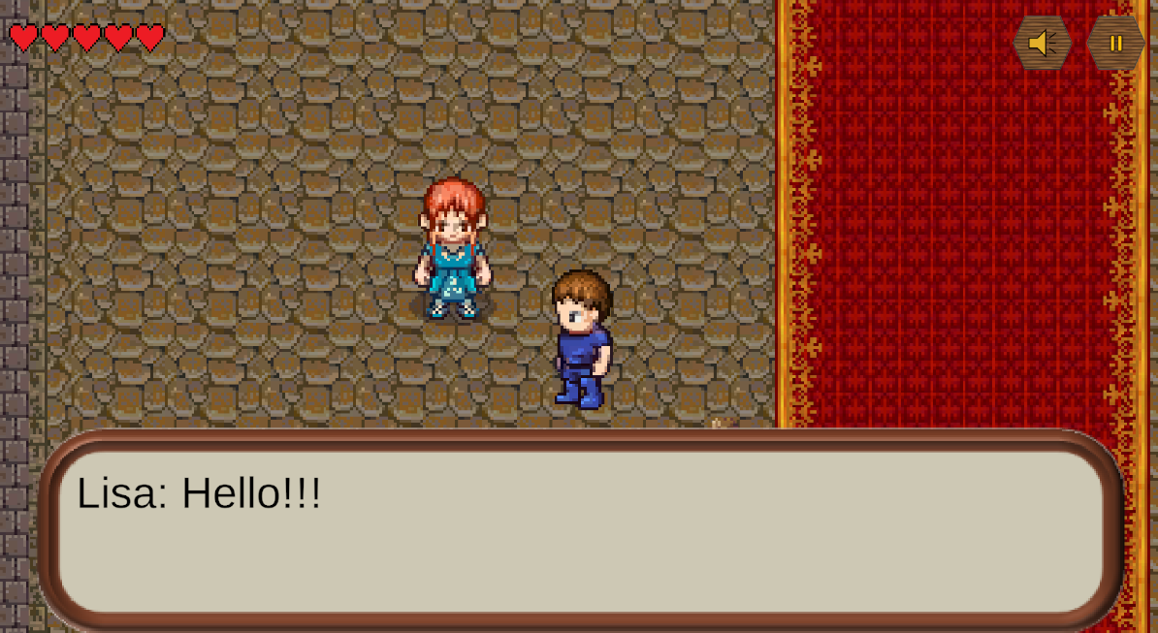
Interaction with the NPC(Non-Player Character)
Conversation with the NPC in the game.
NPC range detection for starting the conversation.
NPC Object
Dialog
DialogueTrigger

Slide 21
Save progress
During the game a player might want to save the game to keep all the progress.
When a player is killed or quits a game he might restart from the latest save he made.

Slide 22
Save progress video demo
Here we can present a video demo of save feature.

Slide 23
Resources used
The sprite sheets of the characters, textures of the maps and objects, and soundtracks integrated into our game were sourced from publicly available collections on the internet, ensuring that all materials used are freely accessible and suitable for our development needs.

Slide 24
Thank you for you time!

